Slide 1
Leo Hayes High School Catchment Area Study
October/November, 2016

Slide 2
History
The Anglophone West School District Education Council (ASD-W DEC) showed an interest in the enrolment at Leo Hayes High School (LHHS) and the potential of expanding the building. DEC noted the school was crowded with a number of modular classrooms.
An independent study was commissioned by ASD-W and the Department of Education and Early Childhood Development (EECD) to examine the overcrowding at LHHS.
Ernst & Young, an independent consulting firm, conducted the study and presented a report to DEC and EECD in December, 2015. This was a public meeting.
Within the report were a number of recommendations for changes in catchment area for LHHS.
This report is a public document and is found on the ASD-W website…

Slide 3
Next Steps
The DEC assumed responsibility for reviewing the catchment area and making subsequent decisions.
The DEC formed a sub-committee of Councilors and staff to analyze the Ernst & Young report and come up with recommendations for Council.
The sub-committee presented to DEC in May, 2016. The recommendations are found on our website.
These catchment area recommendations aligned with the Ernst & Young report.
There were the four major recommendations from the sub-committee:
Movement of students in the area below Portobello Drive and the Burton Bridge
Movement of students in the area between the Princess Margaret Bridge and Portobello Drive (including Portobello)
Movement of students in the Durham Bridge area
Movement of students in the Keswick Valley area

Slide 4
Recommendations Approved by DEC
At the May, 2016, Public DEC meeting, the Council adopted the report and approved the recommendations.
At this same meeting, the DEC also approved an addition to LHHS as their #1 priority for major capital construction. This addition would be an area for skilled trades and estimated to cost $1.9 million.
It should be noted that Leo Hayes High School is a P3 facility…a public-private partnership.

Slide 5
This Fall
At the September, 2016, Public DEC meeting, the Superintendent submitted a proposed action plan for DEC’s consideration and approval. It was approved.
Within this action plan, there was a determination that the Superintendent would host 3 public meetings to share information and seek feedback from stakeholders.
These meetings, which will be similar in nature, are scheduled for:
October 13 at Nashwaak Valley Elementary School
November 9 at Keswick Valley Memorial School
November 28 at Leo Hayes High School

Slide 6
Next Steps
On December 8, 2016, at the regularly scheduled Public DEC Meeting, the Superintendent will submit recommendations to the Council.
In January, 2017, the Council will either confirm the original motion from May, 2016, or make a new motion should revisions to the plan be required.
Specific details to any changes will be communicated in February to June, 2017, to all affected parties. This may include any grand-fathering scenarios.
September, 2017, the changes will roll out.

Slide 7
#1. Movement of students in the area below Portobello Drive and the Burton Bridge
Currently this area is zoned for Barker’s Point Elementary School for K-5. These students would go to Assiniboine Avenue Elementary School for K-2 and Hubbard Avenue Elementary School for 3-5.
Currently this area is zoned for Devon Middle School for 6-8. These students would go to Ridgeview Middle School or Harold Peterson Middle School (depending on FI) for 6-8.
Currently this area is zoned for Leo Hayes High School for 9-12. These students would go to Oromocto High School for 9-12.

Slide 8
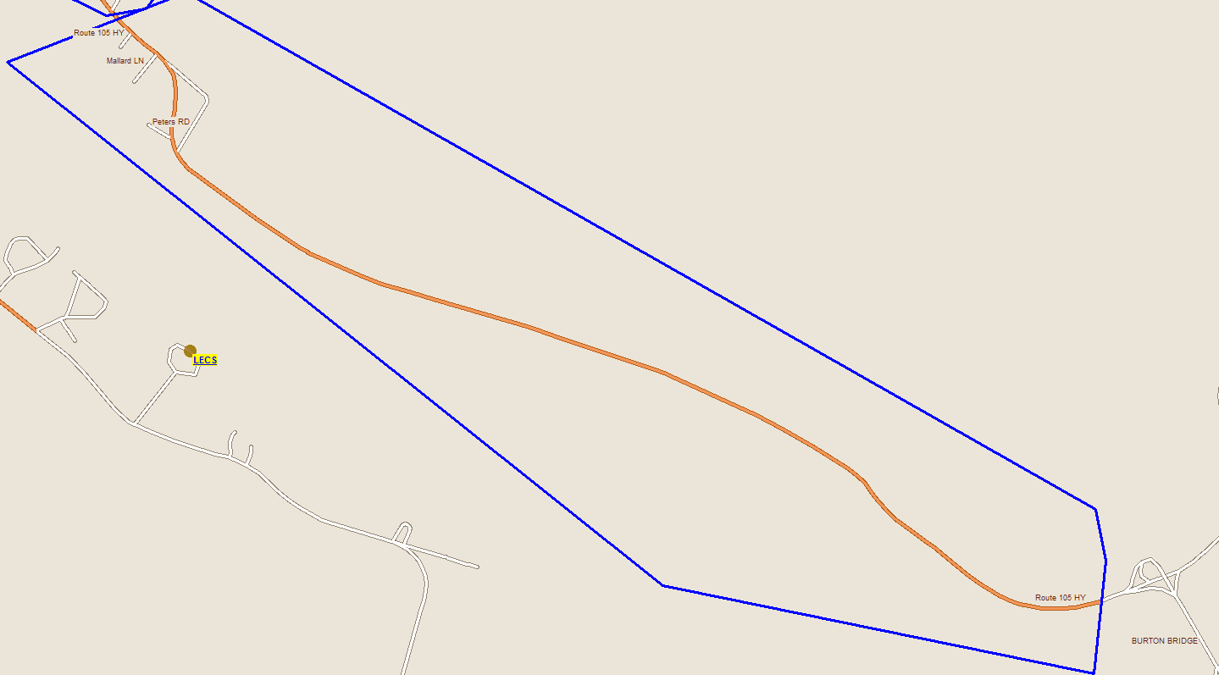
Proposed Below Portabello Drive to Burton Bridge
# of potentially impacted students in zone
K - 5 = 14
6 - 8 = 4
9 - 12 = 11
Total = 29

Slide 9
Demographic Information – September, 2015 Numbers
Below Portabello Dr
 | Current Busing Time Average |  | New Busing Time Average
BPE | 30 Minutes | AAE | 45 Minutes
DVMS | 38 Minutes | HAE | 40 Minutes
LHHS | 39 Minutes | RVMS/HPMS | 30 Minutes
 |  | OHS | 35 Minutes

Slide 10
Below Portabello Drive to Burton Bridge - Stats
Impacted School | Current Enrolment | Functional Capacity
Barker's Point School | 351 | 81.3%
Devon Middle School | 499 | 70.4%
Oromocto High School | 1135 | 64.5%
Ridgeview Middle School | 319 | 36.9%
Harold Peterson Middle School | 328 | 35.2%
Hubbard Avenue Elementary School | 269 | 53.2%
Assiniboine Avenue Elementary School | 249 | 62.2%

Slide 11
#2. Movement of students in the area between and including Portobello Drive and the Princess Margaret Bridge
Currently this area is zoned for Barker’s Point Elementary School for K-5. These students would continue to go to Barker’s Point Elementary School.
Currently this area is zoned for Devon Middle School for 6-8. These students would go to Bliss Carman Middle School for 6-8.
Currently this area is zoned for Leo Hayes High School for 9-12. These students would go to Fredericton High School for 9-12.

Slide 12
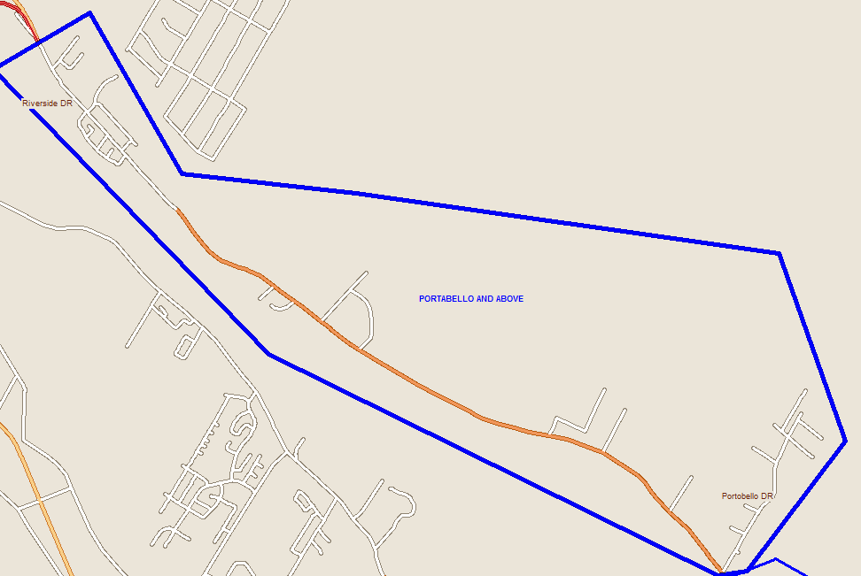
Proposed Portabello Drive and Above
# of potentially impacted students in zone
6 - 8 = 22
9 - 12 = 36
Total = 58

Slide 13
Demographic Information – September, 2015 Numbers
Portabello Dr and Above
 | Current Busing Time Average |  | New Busing Time Average
BPE | 15 Minutes | BPE | 15 Minutes
DVMS | 22 Minutes | BCMS | 20 Minutes
LHHS | 20 Minutes | FHS | 25 Minutes

Slide 14
Portabello Drive and Above
Impacted School | Current Enrolment | Functional Capacity
Bliss Carman Middle School | 582 | 86.8%
Fredericton High School | 1960 | 67.9%

Slide 15
#3. Movement of students in Durham Bridge Areas
Currently this area is zoned for Nashwaak Valley School for K-5. These students would continue to go to Nashwaak Valley School.
Currently this area is zoned for Devon Middle School for 6-8. These students would go to Stanley Consolidated School for 6-8.
Currently this area is zoned for Leo Hayes High School for 9-12. These students would go to Stanley Consolidated School for 9-12.

Slide 16
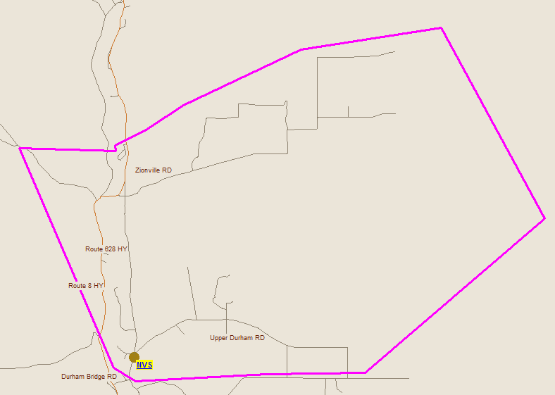
Proposed Durham Bridge
# of potentially impacted students in zone
6 - 8 = 21
9 - 12 = 36
Total = 57

Slide 17
Demographic Information – September, 2015 Numbers
Durham Bridge Split
 | Current Busing Time Average |  | New Busing Time Average
NVS | 25 Minutes | NVS | 25 Minutes
DVMS | 52 Minutes | SCS | 50 Minutes
LHHS | 43 Minutes

Slide 18
Durham Bridge Split
Impacted School | Current Enrolment | Functional Capacity
Stanley Regional High School | 250 | 51.7%
Devon Middle School | 499 | 70.4%

Slide 19
#4. Movement of students in Keswick Valley Area
Currently this area is zoned for Keswick Valley Memorial School for K-8. These students would continue to go to Keswick Valley Memorial School.
Currently, part of this area is zoned for Leo Hayes High School for 9-12. These students would go to Nackawic High School for 9-12.

Slide 20
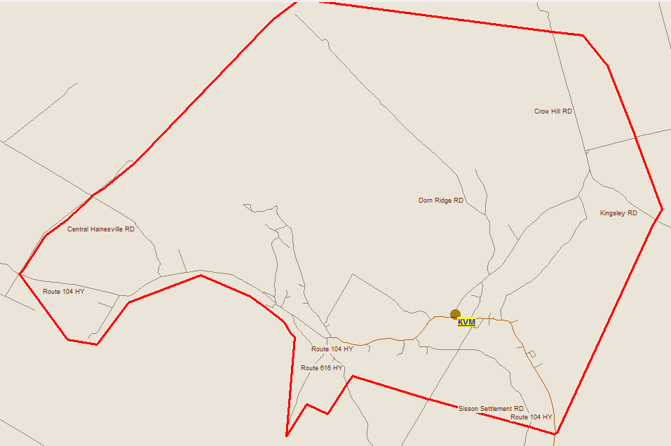
Keswick Valley Catchment Area
# of potentially impacted students in zone
9 - 12 = 69

Slide 21
Demographic Information – September, 2015 Numbers
Keswick Valley Area
 | Current Busing Time Average |  | New Busing Time Average
KVMS | 20 Minutes | KVMS | 20 Minutes
LHHS | 43 Minutes | NHS | 55 Minutes

Slide 22
Keswick Valley
Impacted School | Current Enrolment | Functional Capacity
Nackawic High School | 262 | 45.0%

Slide 23
Other Considerations
Out of catchment request data
Grand-fathering
Overall shift of enrolment based on September/15 numbers
Enrolment change from 2015 to 16

